Slide 1

PYTHON Loops - Break

Slide 2


Break Statement in Python
A break statement is usually used to terminate a loop.
When a break statement is executed, the statements after the contents of the loop are executed.
A break statement can be placed inside a nested loop.
If a break statement appears in a nested loop, only the inner loop will stop executing. The outer loop will continue to execute until all iterations have occurred or until the outer loop is broken using a break statement.
So, one can use break statement to exit a loop when a specific condition is met instead of running the whole loop.
We declare a break statement within the loop, usually under an if statement.

Slide 3
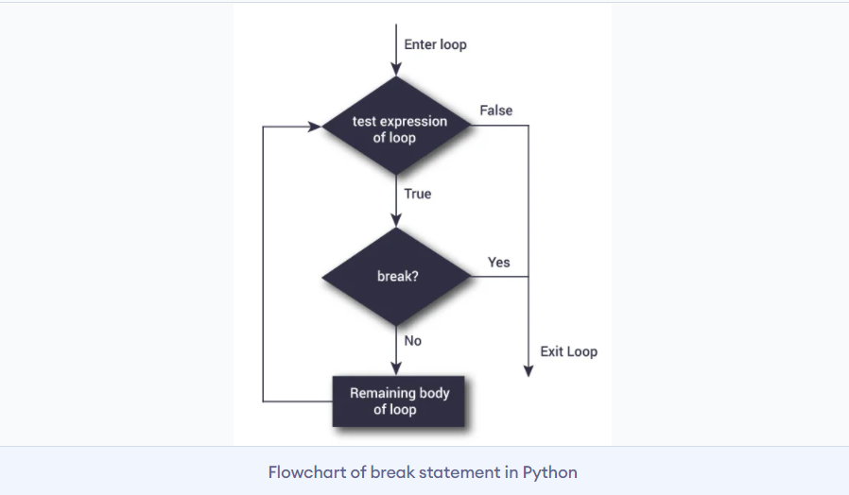
Syntax
break
The working of break statement in for loop
for var in python:
#codes inside for loop
if condition:
break
#codes inside for loop
#codes outside for loop
Flowchart

Slide 4
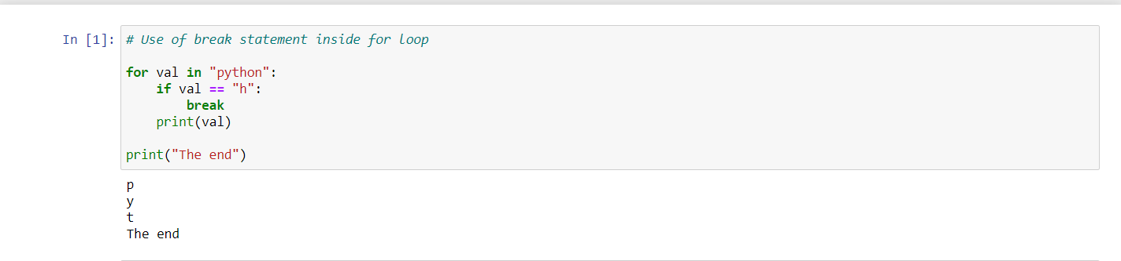
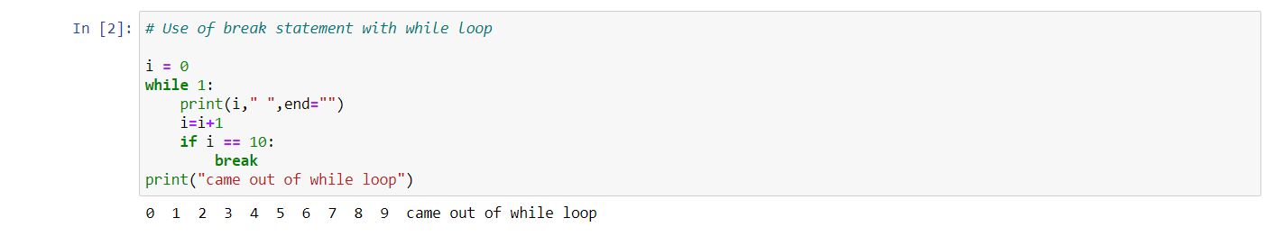
Some code examples

